Slide 1

OUR HOUSE
Regional Roadshows Q1 2024
Cascade
February 2024
Notes:
Morning/Afternoon.
Today’s Team Talk is all about sharing the key messages from the Regional Roadshows and us talking about what – and how we’re going to make sure we deliver fantastic results this year, growing our live credit customer accounts and being a really strong team.

Slide 2
Today’s Team Talk
1
Safe to do the right thing
5
What’s getting in the way
2
6
Our current position
Tell Us! Results & values driving performance
3
7
Our progress in 2023 & roadmap for 2024
Next steps
4
8
Category update
Trust in Better – our shared commitment
Notes:
This is the agenda for what we’re going to talk about.
Our Team Talk isn’t going to be me talking at you. I’m going to be asking all of us to get involved in the conversation.
We all have our part to play in winning in 2024.

Slide 3
Safe to do the right thing
Notes:
We’re going to start today’s Team Talk by looking at Safety.
The safety of our customers and colleagues isn’t an option; it’s something we’ve got to keep left, right and centre of everything we do and how we operate.

Slide 4











Safe to do the right thing
Our safety record in 2023 and focus for 2024
Incident Category | Lost Time Injury LTI | Minor Medical Treatment MMT | First Aid Injury FAI | Near Miss Incident NMI
Total no. of Incidents 2023 | 2 | 0 | 81 | 1804
Some incidents were SIPs meaning they had much greater potential for serious injury
COLLEAGUES
HARM / INJURY
Commercial Vehicle Delivery Drivers
Yard & Warehouse staff
Musculoskeletal / digits & upper / lower limb injuries
Severity increases with vehicle falls & FLT impacts
ACTIVITIES
LOCATION
Manual Handling
Commercial deliveries & FLT collisions
Yard & Warehouse (mainly vehicle loading areas)
Off-site deliveries (limited environment familiarisation or control)
TOP ROOT & UNDERLYING CAUSES
1. MANAGEMENT SUPERVISION & BEHAVIOURAL INFLUENCE
2. RISK ASSESSMENT
(Improper, inadequate local implementation)
3. DELIVERY LOAD PLANNING
Notes:
Overall, a very good performance in terms of frequency and the types of accidents experienced in the region, in comparison to historic performances over the years.
The severity of injuries, which thankfully year on year reduces in terms of the impact of those injuries on the injured colleagues, and the length and complexity of their recoveries.
2 lost time injuries, thankfully none of them were very serious injuries, however some incidents had much greater potential for serious injury and were therefore treated as a SIPs (Serious Injury Potential) and underwent vigorous investigation and senior management reviews as a result - and some of those SIPs were near misses which is a great opportunity for us to learn.
No significant professional medical treatment injuries on the books and a total of 81 first aid injuries, low in severity.
A healthy number of near miss reports, indicating that our culture of open and honest reporting remains something for us to be proud of.
In terms of who gets injured, it’s our Drivers and yard or warehouse teams – at the sharp end and working with the hazards – hence why hazard control (including behaviour – which is the hardest hazard to manage) is so important.
The main activities that cause injuries are manual handling and driver activities (including Tool Hire) and of course Forklift truck operations.
Thankfully, right across the business the severity or level of harm has predominantly been low impact manual handling related injuries, fingers and limb injuries. The risk of severe injury increases by multiple factors once to add working at height and forklift trucks into the causation – so we must continue to focus on these areas through 2024.
No surprises for the general location of most of the regions injury experience – yards and warehouses and of course off-site when our teams are delivering to unfamiliar environments where we have limited control – and here is the importance of dynamic risk assessment and common sense behavioural safety.
It needs to be said however that when we look at the ROOT and UNDERLYING CAUSES:
Supervision and influence over our teams working practices and behaviour
Need to do proper risk assessments and plan deliveries better, mainly taking basic information from our customers before sending our Drivers out. This way they can take steps to load in a certain way, or get support – or just be more aware of the hazards and risks at the location they’re about to head off to.

Slide 5
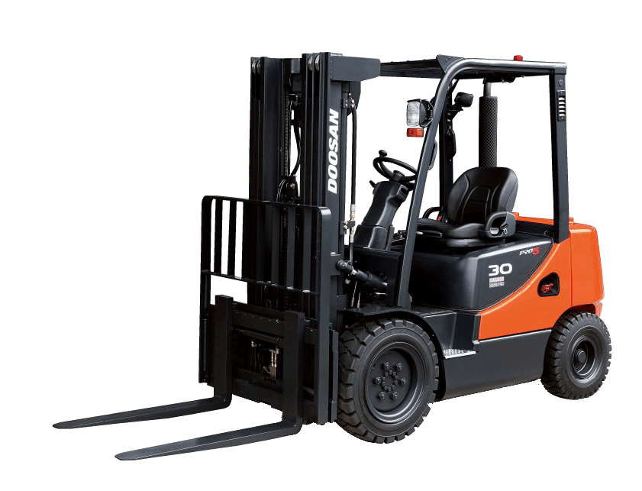
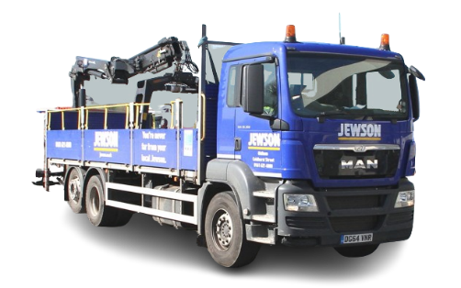





Safe to do the right thing
Our focus for 2024
FLT
Safety
PRACTICAL MANAGEMENT SUPERVISION & INFLUENCE
1
FLTs – Safe Working Exclusion Zone
Drivers – Crane use, accessing cabs & beds
Asbestos – Managing damage
& monthly ACM checks
Products – Storage / manual handling & adverse weather
Competent to manage EHS?
Get with the programmes
i.e. SMAT Conversations
EHS
Learning & Development
5
2
Driver
Activity
Product Safety
4
3
Asbestos
Management
Notes:
For 2024, our focus doesn’t change, we just have really stay focussed and be consistent in that, and that means being better at ‘practical and pragmatic management supervision and influence’.
We’ve got to keep to high standards and I’ll be helping you do to that. STARK Connect (formally known as SMAT Connect) can help us too.
Priority number 1 – is our biggest operational hazard, Forklift trucks. Almost EVERYTHING links to our teams making sure that the safe operating exclusion zone is managed – kept clear at ALL times when the FLT is in motion. This is the most critical operational rule we have, this and looking in the direction of travel at all times, especially when reversing. If we manage this well, we just don’t hit people – it’s as simple as that.
Priority number 2 – As you’d probably expect, it’s Driver activities. Driver accidents when out delivering, or loading and unloading vehicles, result in around 50% of all our injuries, and they’re usually the most severe. We need to focus and influence how they work at height and that’s predominantly accessing and exiting the vehicle cabs and when needing to access the vehicle bed – remember feet on the ground is key, followed by using the fall prevention bars (Safe-T-Drop) and always having 3 points of contact.
Priority number 3 – Asbestos! We know what to do, and it’s more simple than it seems. We just have to make sure we know the locations of asbestos containing materials at our branches, (from understanding our individual site survey), and I need to keep you informed on these locations so we all treat them with care and delicacy, and openly report to you if they accidentally damage any ACMs. Finally, physically inspect these areas once a month; we need to make sure we’ve noted down on our monthly EHS inspection sheet, and of course immediately report any damage identified to Property so we can urgently fix it to make it safe. We cannot afford to ignore any damage or disrepair to asbestos containing materials in our branches.
Priority number 4 – Product safety. This predominantly means how we handle products, how we store them, how we load and move them around and to our customer. The key things to focus on and influence your teams over are always – manual handling (make sure your teams are trained, it’s risk assessed, you’ve recorded their physical capabilities) and observe occasionally that they’re adopting common sense good practices when physically handling stock. The other key area is storage, stacking of packs and please remember that whenever we have adverse weather (in particular high winds) which seems more and more frequent these days, we need to be making sure external sock is secure and we’re not creating surface to air missiles through carelessness or just bad practice.
And Priority number 5 – EHS training. Coaching is the key, now carried out in small, subject-specific workshops in informal familiar settings, which are a set of short group sessions called ‘EHS Lite’. The approach now in EHS is to coach not catch, less audits and much more support, so don’t hesitate to shout for help.

Slide 6
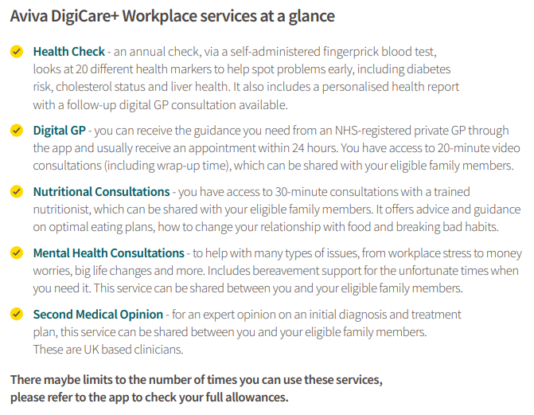

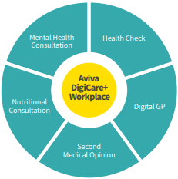
Aviva DigiCare+
Workplace services at a glance
Notes:
We’ve moved on from MHS, which we know helped a number of people and saved lives.
Pleased to say Aviva’s offering has even more for us.
Digi Care + still covers Mental Health but also a much wider offer, and also for our families – in days when we struggle to see GPs.

Slide 7
OUR CURRENT POSITION
Notes:
So, let’s talk about how things are today with our business and what this means for us.

Slide 8


POISED FOR
GROWTH
Notes:
We need to turn around the overall financial performance of the business across all of STARK UK, and that has to start and end with driving the number and size of live credit accounts.
We’re currently operating in a very challenged market and yet we have a fantastic opportunity to deliver on our Trust in Better strategy and plans.
We’ve made and will continue to make lots of little – and big improvements that will make the whole situation better. The sum has to be greater than the individual parts.
We’re seeing lots of pockets of brilliance – and need to see more.
There’s a lot of lifting and shifting of best practice we need to do and also a lot of unpicking and sorting out issues that have come from previous ownership with Saint-Gobain.

Slide 9

OUR
BLUEPRINT
FOR SUCCESS
SIMPLIFICATION
THE CUSTOMER
THE BRANCH MANAGER
Notes:
We need to do the basics brilliantly.
Branch teams are the focus and support functions are here to help give every chance for success.
Our customers are and have to be at the heart of everything we do.
And, we really need to keep things simple. As a builders’ merchant, we buy, stock and sell; we need to move the barriers to be close to our customers.
And, we need to hold and grow our customers.

Slide 10

OUR
STARK
FACTOR
WHAT DOES SUCCESS LOOK LIKE?
Notes:
Our STARK factor – our secret sauce?
It’s our products, range, availability and guidance to ensure a fair price.
It’s our focus on customers and the expertise we offer and how we partner with them to go above and beyond, every time.

Slide 11

WHAT’S
STOPPING
US?
FROM GOOD TO GREAT!
Notes:
The Trust in Better strategy is removing the things getting in the way, so there’s really nothing that’s stopping us focusing on our customers. That’s what we need to focus on.

Slide 12

LET’S HAVE MORE
BRILLIANCE
Notes:
Bring a little bit more brilliance every day.
Every single improvement adds up to an even greater result.

Slide 13



Our progress in 2023
& roadmap for 2024
Notes:
We’ve got a simple strategy that will get us to being the UK’s number one builders’ merchant.

Slide 14









Trust in BETTER
A roadmap to our BETTER future
Our big ambition
We want to be the UK’s #1 builders’ merchant, enabled by our Trust in Better Strategy
As STARK UK, we have the power to get there, because our whole family of brands will benefit from the additional scale and reach that being part of STARK Group brings, including improved buying strength
8 SPECIALIST BUSINESSES
BETTER starts with each of us. BETTER starts today. Trust in BETTER
Notes:
Every business has a clear plan and our specialist businesses each have a clear focus:
Jewson Civils Frazer – Electric and water.
Minster – Dry cladding and fire protection.
International Timber – Higher value-added engineered timber.
Etc.

Slide 15





7 Specialist businesses
Notes:
We have the ambition to be the number 1 builders' merchant. That means that we want to be the first choice of merchant for the small
and medium local jobbing builder. Our Strategy for Jewson is focussed entirely on achieving that ambition
Before I explain the detail of that let me just explain about some of the specialist businesses in the group
7 Specialist Businesses
Minster
Specialist distributors of interior solutions, dry lining and insulation, partitions, roofing and ceilings. Minster focus is on extending our specialist ranges, incorporating new suppliers and innovations for the growing areas of fire, facade, ceiling and insulation offer and working hard on our target project pipelines
Frazer
JCF also extending ranges focussing particularly on multi-utility and surface water management propositions and engaging early in key projects and framework opportunities and further develop the power and infrastructure pipeline
Normans
Fascinating, great very broad General Builders Merchants, Civils, Offsite manufacture and assembly, Steel bending, Kitchens and bathrooms, Hire, Agriculture, Auto Marine
JP Corry
JPC looking to enhance specialist ranges and Value-added products, through our technical teams such as facades, water management, doors & washrooms, reviewing options for toll hire addition and a major revamp of the flagship site at Springfield Road with planning now approved
MBS
Major Build Solutions operates from 6 dedicated hubs across Great Britain offering a unique proposition to our large housebuilder customers, planning to double the revenue generated in the next 4 years. We will also expand the geographic footprint with a new site in the NW.
JPS
Fabulous proposition for the public sector RMI segment of the business. Great guns and growing fast, multiple recent wins. Doubled sales over past 4 years and planning to do the same over the next 4 years. Will be over 70 standalone stores in 2024
International Timber
Key focus is to drive Growth in Hardwoods (mainly Machined), laminated, cladding, specialist panel and Modified products with improved profitability

Slide 16

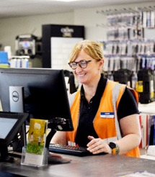
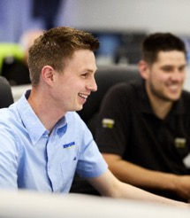
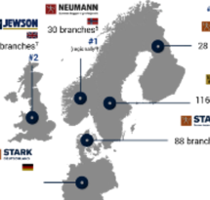
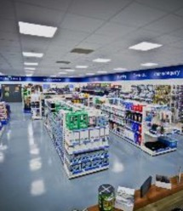
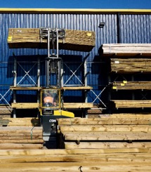

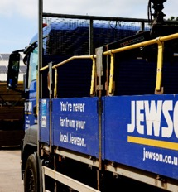
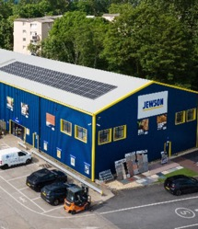
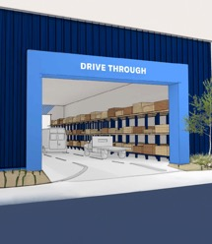
Jewson’s key strategic priorities
ORGANISATION SIMPLIFICATION
BRANCH TEAMS @ HEART
BETTER PRICING GUIDANCE
STARK GROUP SOURCING POWER
COMPLETE RANGE FOR THE JOB
ALWAYS IN STOCK
TOOL HIRE GROWTH
TRUSTED DELIVERIES
BETTER BRANCHES
BRANCH OF THE FUTURE
Notes:
There are 10 priority areas we’re focusing on as Jewson.
We’ve simplified the organisation and its structure; we’re simplifying policies and procedures too.
Cost reduction has been a primary focus, but it’s also about being able to enable quicker decision-making, which the new structure now supports.
Branch teams are at the hear and now have the autonomy to focus on local business and local marketing conditions. Branches now have accountability for EBITDA and P&L.
We need to keep close to market prices and that’s why there’s now very clear guidance that we have to keep to, to offer a fair price AND also protect our margins. Guidance for the remaining SKUs is only weeks away and we can now focus on volume and margin uplift.
Because we’re part of STARK group, we can benefit from their scale and also sharing experiences across our country cousins.
For Jewson to be a proper builders’ merchant, we need ~9,000 SKUs to provide small and medium jobbing builders with what they need for the job. The range is being worked on and there are some exciting new products on their way. Not all branches will be able to fit 9,000 skus but we are confident that we can increase the numbers in many branches, AND we can of course still get all the other items and more for customers when they need them within a few days. The team are working on a detailed where to buy guide
When it comes to stock, we need to be at least 96% availability, and we need to actively manage this. Relex is a forecasting tool that is now in about a third of branches and is being rolled out to help every operational team keep on top of having the right product mix and availability.
Tool Hire is a great margin business and we’re reviewing the fleet, also investing to make sure there are more and bigger sites for customers.
We need to be delivering 10 drops a day; five is the average and that’s not good enough. We’re going to be getting PDP level technology to also help improve the delivery experience for customers, drivers and in-branch teams alike.
Our branch network will continue to be reviewed to make sure we’re meeting market conditions and providing customers with the service they need. There’s a plan in place to make sure sites are being improved, from drainage and pothole issues, to toilets and roofs. STARK Group understands merchanting and that’s why there’s a multi-million Pound investment being made to improve branches over the next four to five years.
When it comes to new Branches of the Future, the first application is in and everyone’s hoping it will be open in August. It will be much bigger, with a drive-through and also a temperature controlled room for mouldings.

Slide 17



Our progress – Autumn 2023
Sep 2023
Locally-based pricing guidance rolled out for KVIs
October 2023
Loss & damage waiver launch
October 2023
Tool Hire opened in Jewson Andover branch
Nov 2023
Price guidance extended to middle tail items
Dec 2023
Build Aviator process simplification / Flight Deck
Sept
Oct
Nov
Dec
Sep 2023
Distribution Centre service restructuring scoping
Oct 2023
Material cost price reduction
Ongoing
Acquisition of Raptor Brand and existing Own Brand clearance commenced
Dec 2023
New Bonus Scheme letters sent to all colleagues
Organisation simplification
Branch teams
at the heart
Better pricing guidance
STARK Group sourcing power
Complete range for the job
Always in stock
Tool Hire growth
Trusted deliveries
Better branches
Branch of the future
Notes:
September – Specials margin guidance and KVI pricing guidance.
September - DC restructure scoping.
October - Tool Hire Loss and Damage Waiver and Equipment investment.
October - Material cost price reduction.
October - Raptor new own brand and old brand clearance.
November - Price Guidance to middle tail.

Slide 18
Our next priorities
Jan 2024
MDT simplification
Jan 2024
Template terms launches
Feb 2024
New strategic propositions for Doors
Mar 2024
New and revised Decorating & Drainage propositions
Apr 2024
Fixings & Ironmongery
Jan
Feb
Mar
Jan 2024
Regional Roadshows
Feb 2024
New strategic propositions for Landscaping
Feb 2024
Ongoing injection of new crane vehicles
Mar 2024
Management training & development programme
Organisation simplification
Branch teams
at the heart
Better pricing guidance
STARK Group sourcing power
Complete range for the job
Always in stock
Tool Hire growth
Trusted deliveries
Better branches
Branch of the future
Notes:
January – Template terms to lapsed customers.
January – Regional Roadshows.
January – MDT flow simplification.
Q1 2024 – 100+ new crane vehicles.
Q1 2024 Decorating, workwear and Metalwork Ranges.
Q1 2024 new Landscaping Doors and Drainage propositions.
Mar 2024 – Management training and development programme.

Slide 19
Our plan to 2027
*subject to change
Ongoing
Investment in branches and network optimisation
Ongoing
Pricing guidance enhancement
Jul 2024
Launch of CRM system to support branch autonomy and accountability
Apr 2025
Automated forecasting system roll out completed
Ongoing
Distribution Centre service restructuring
BETTER BRANCHES
BETTER PRICING GUIDANCE
BRANCH TEAMS AT THE HEART
ALWAYS IN STOCK
2023
2024
2025
2026
Mar-Sep 2024
Improved ranging including Autumn & Winter and Landscaping
Sep 2024
Offline pricing guidance for own hire and re-hire
Mar 2025
Five new Tool Hire hubs
Jun 2025
Price guidance available in ICON
TOOL HIRE GROWTH
May 2024
New strategic propositions and revised ranges for Decorating, Workwear & Builders Metalwork
Aug 2024
First branch
of the future opens with more to come
Nov 2024
Rollout of new devices and delivery tracking system
Oct 2023
Material cost price reduction
TRUSTED DELIVERIES
STARK GROUP SOURCING POWER
COMPLETE RANGE FOR THE JOB
BRANCH OF THE FUTURE
Notes:
Current work.
Branch investments ongoing – Rutherglen, Bridgwater, Cardiff
Branch investments in plan pre-August 2024.
Further material price reductions – some possible bigger sourcing moves being developed.
July 24 CRM launch.
Tool Hire Growth.
Tool Hire hubs.
Relex roll out completion.
Further DC improvements and medium-term planning.
Planning application - we are intending to open Branch Of The Future in August subject to any planning delays

Slide 20

CATEGORY
UPDATE
Notes:
Our Category team is focused on making sure branches are set for success too.

Slide 21



Category update
Must Win Activities
Fix the Basics
Own Brand
Governance
    “Best” Small Medium Large range
    Fill Gaps: Add missing ranges/
    products and develop opportunities
    Drainage, Decorating, Roofing
    Comprehensive Group approach
    Screws and Ironmongery April – May
    Exit S-G 2024
    Trading Board
    Customer Board
Notes:
Fix the Basics.
“Best” Small Medium Large range.
Fill Gaps: Add missing ranges/products and develop opportunities: Drainage, Decorating, Roofing.
Own Brand.
Comprehensive Group approach.
Screws and Ironmongery, April – May.
Exit S-G 2024.
Governance.
Trading Board.
Customer Board.

Slide 22

Category structure
Rich Sykes
Product
Sustainability
& Compliance
Director
category.support@jewson.co.uk
Rob Williams
Category Director
Timber & Panel
Gary Venn
Commercial
Director
BRANCH OF THE FUTURE
Ann Whittle
Head of Supplier
Engagement
Shaun Walsh
Category Director
HBM
Steve MacDavid
Category Director
LBM & Finishings
Notes:
The Category team is now structured to be focused on branch operations.

Slide 23
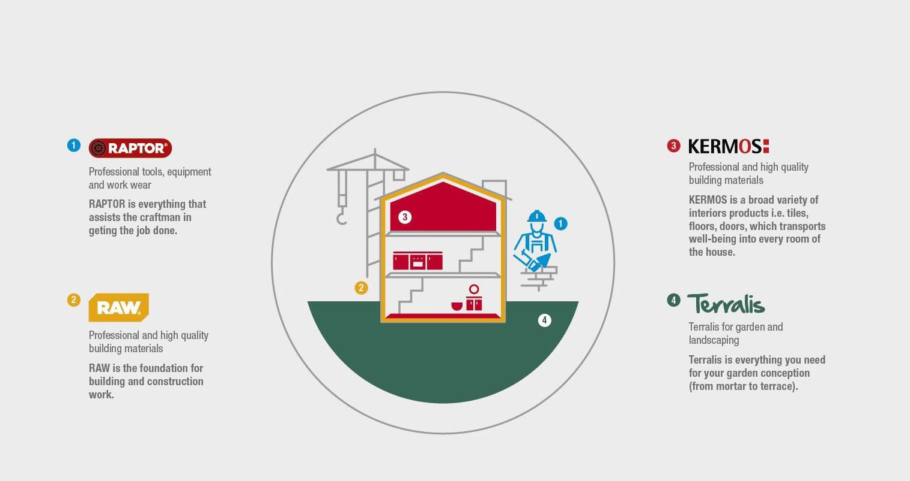

The new brand house
Notes:
We’ll have a great four-pronged own-brand category mix that will set us apart from the competition.

Slide 24
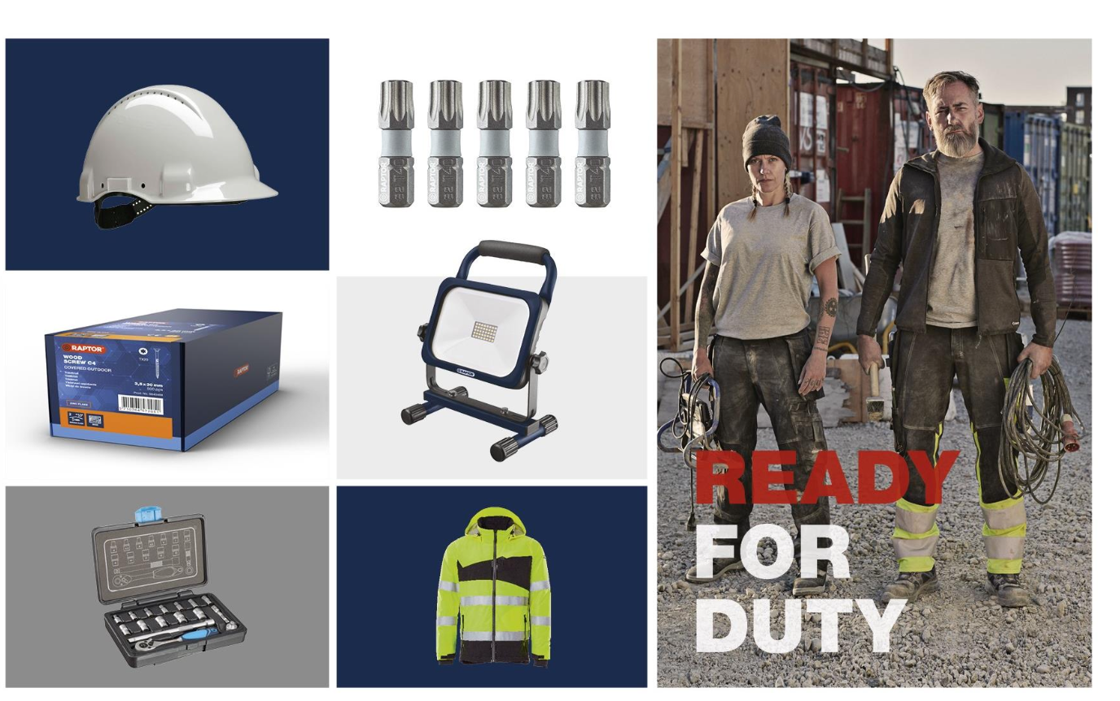

‘Everything that
assists the tradesmen
in completing the job’
The Enablers
Tools
Lighting
Equipment
Workwear
Fastenings

Slide 25


‘The foundation of building construction work’
The invisible construction materials
Cement
Plasterboard
Roofing
Blocks
Insulation
Timber
Drainage

Slide 26
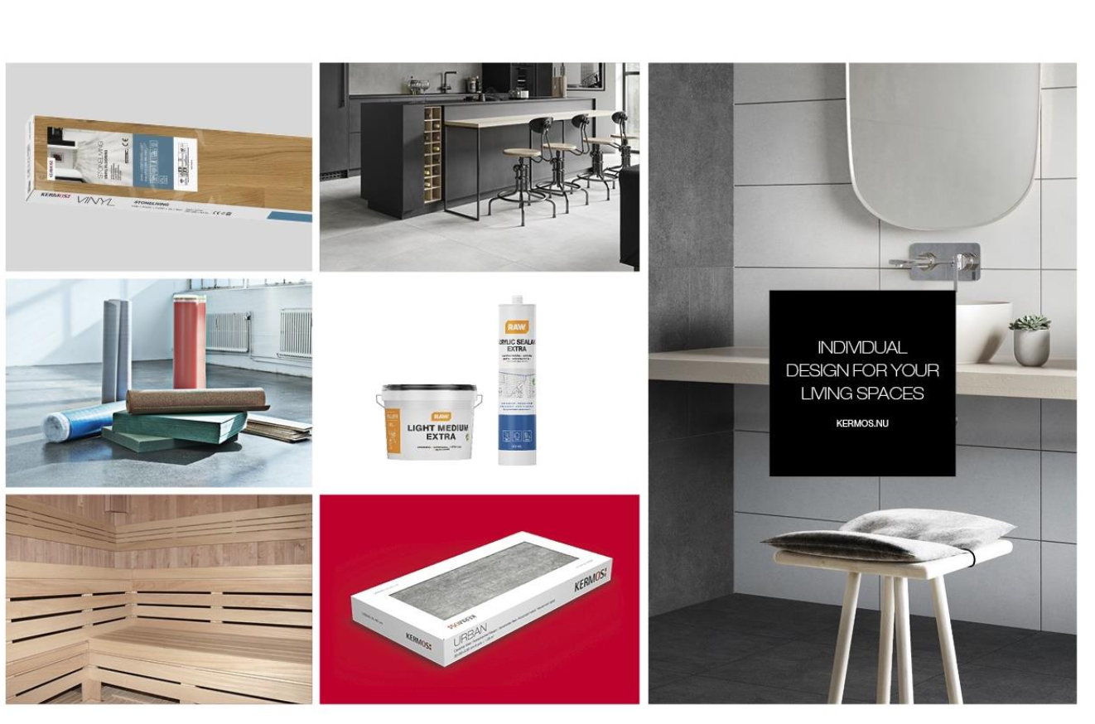

‘Transporting Wellbeing into every room’
The decorative building products improving the
look and feel inside your home
Tiles
Flooring
Kitchen
Bathroom
Doors
Paint

Slide 27
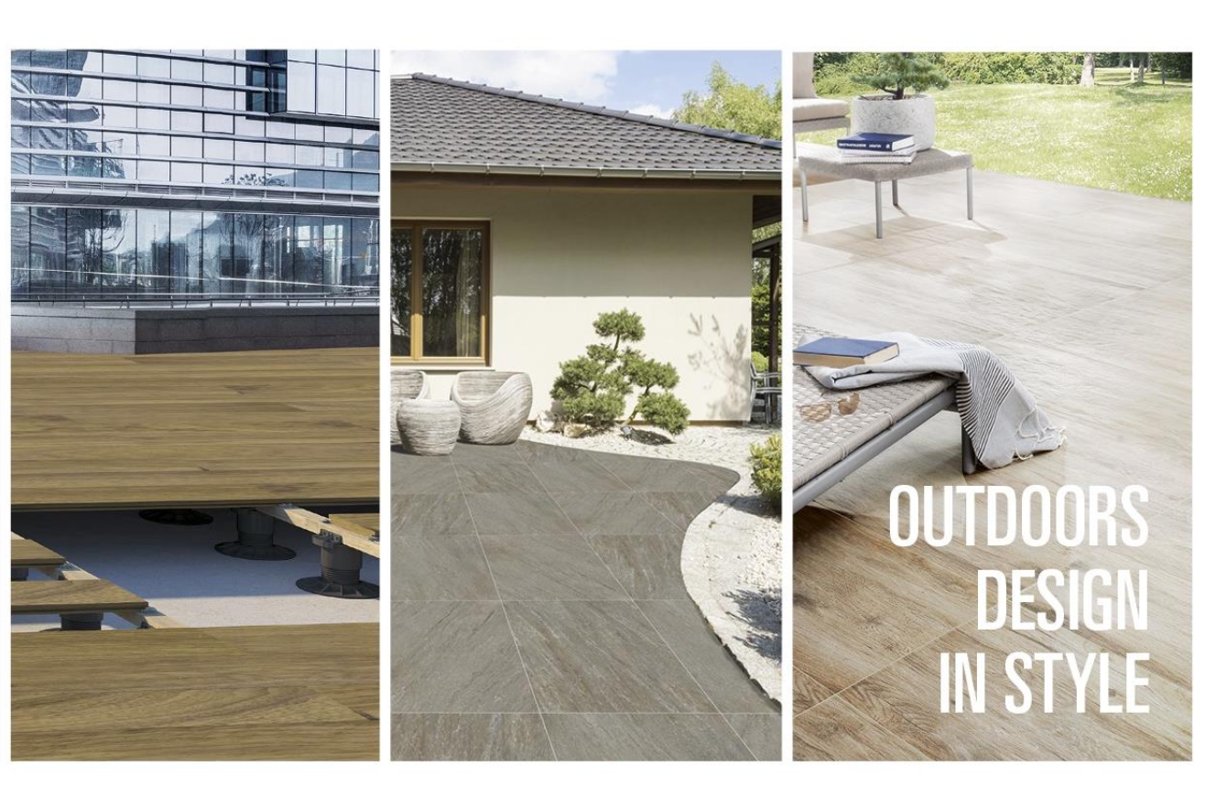

‘Everything you need for your garden conception’
Products and solutions
for all your landscaping, gardening, and outdoor construction
Paving
Decking
Garden Buildings
Driveways
Artificial Turf
Fencing
Natural Stone

Slide 28
What’s getting in the way?
Notes:
You’ve now got an update on where we are with the Trust in Better strategy and we can see there’s been a lot of progress – with plans still being implemented to deliver the rest of the improvements and changes we need for the company to win.
It’s now over to us to make sure we deliver our part of the plans.
Let’s start with a conversation about what we need to do differently in 2024. What’s working, what’s not, and what do we need to change.

Slide 29
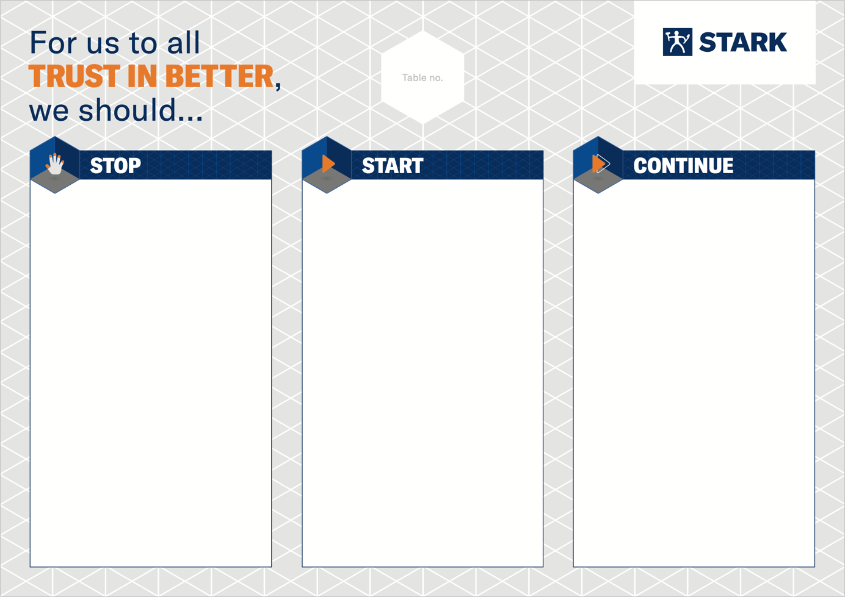



Stop, Start, Continue
Notes:
What will we stop doing that’s not working any more?
What will we start doing to help ourselves?
What will we carry on going, but further improve?

Slide 30

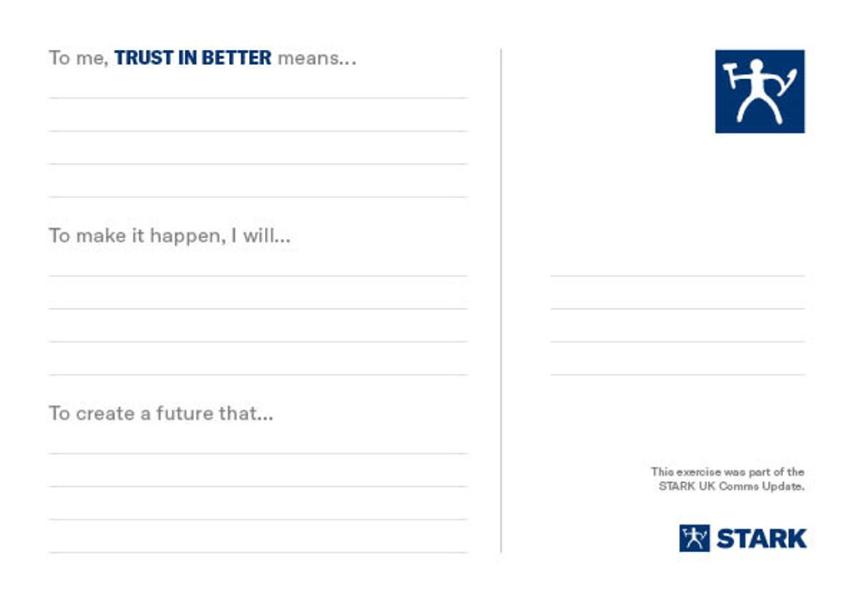
Our Trust in Better Stories
Notes:
Now I’d like you to reflect by yourself for a moment – what you will do differently to make our plans successful.

Slide 31
Tell us!
Survey results
Notes:
We’re now going to turn our attention to the Tell Us! Survey that took place towards the end of last year, in November.
The results from the survey give us a snapshot of how engaged everyone was at that point in time and importantly allow us a really clear insight into what we are doing well.
They also show us where we need to focus more of our energy in terms of staff engagement order to make a positive difference by leading our teams in a values driven way.
Staff engagement and performance go hand in hand so the more engaged our colleagues are the more successful we are as a business.
Added to that the survey results also provide us with a benchmark so that moving forward we can track and measure improvement.
So today I want to share with you the highlights of the Stark UK survey result.
We will look at the NPS (Net Promotor Score), which is a key measure as it is underpinned by all the survey engagement driver questions and is a great indicator of our overall staff culture and engagement.
And finally we will look forward to what we need to do next in terms of the survey results.

Slide 32
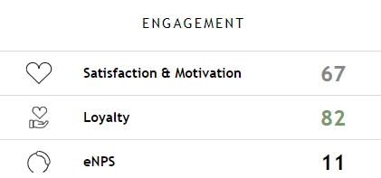
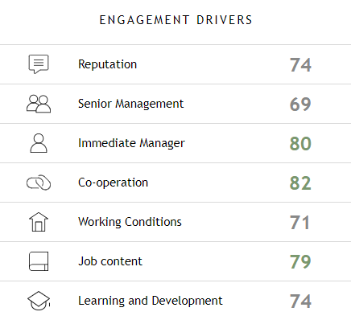









Tell Us! STARK UK Survey results
80%
6,171/7,739
Survey was live
26th October – 21 November 2023
All responses are
confidential
Notes:
80% of staff completed the survey. STARK Group were really pleased with our levels of response, especially when taking into account the level of activity and change that has been, and still is, happening across the business.
The slide shows the three main engagement measures and the seven engagement drivers which underpin the engagement measures. When you look at the scores – green scores are considered as 'good', grey scores are considered as 'neutral' and any figures in red present 'areas of most opportunity' and the great news is that there are no 'red' scores for the measures that you are looking at. As you dig down further into the business unit / branch it is likely that you will see greater variations in the scores.
ENGAGEMENT SCORES are defined by:
Satisfaction & Motivation – Overall, how satisfied are you as an employee at your place of work?
Loyalty – I would like to be employed at STARK UK in two years’ time / I am enthusiastic around the business and my work tasks.
Employee Net Promoter Score eNPS – I would recommend Stark UK as a place to work. This is measured on a scale of -100 to +100) (Good is 0-30, above 30 is excellent, world class is 50+).
An important point to remember is that when colleagues talk about their place of work they talk to other members of staff, they talk to our suppliers and they talk to our customers.
Engagement Drivers are on the right-hand side of the screen and these are seen as the core drivers for employee engagement and are self-explanatory.

Slide 33



Our STARK values
DECENCY
PASSION
PRIDE
Notes:
Our values drive how we show up – how we think and behave.
We’ve all adopting STARK’s values of Decency, Passion and Pride, as we fully integrate with STARK Group.
What do these values mean to you. How do they help you serve our customers and be a good team member?

Slide 34
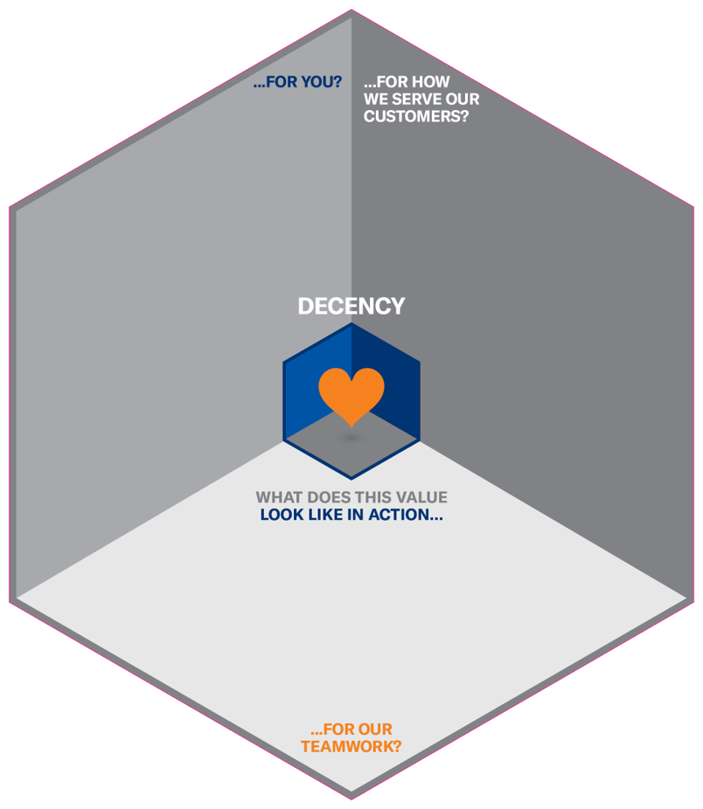
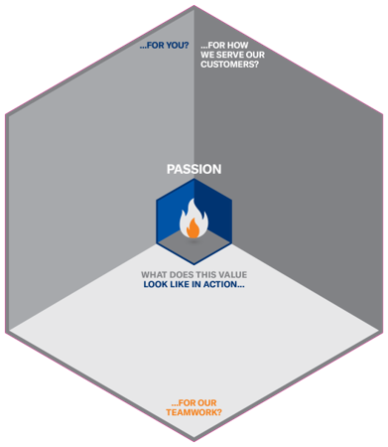
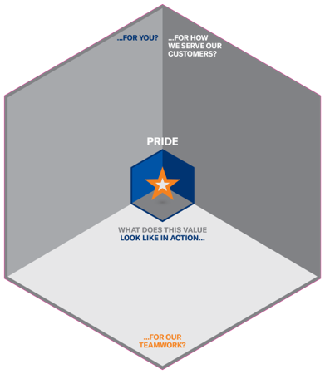

Creating our behaviours
Notes:
Let’s look at one value at a time and explore what this value looks like in action…
…for me?​
…for how we serve our customers? ​
…for our teamwork? ​

Slide 35
Next 100 days
Notes:
We’re now clear on the plans, what we need to do differently and how we will bring our brilliance by living the values every day.
Let’s finish today’s Team Talk by looking at the key priorities and then get going.

Slide 36
Key priorities for the next 100 days
Grow, grow, grow…
Grow our live credit customers
Grow our collections per day
Grow our deliveries per vehicle per day
Notes:
We need to grow our live credit accounts; support functions – everything we do should be in service of our branches.
We need to grow collections per day.
We need to increase the number of deliveries per day.
We need to keep focused on safety, keep talking with each other, and keep in conversation with our customers.
Any questions?

Slide 37
BETTER
STARTS WITH EACH OF US
BETTER
STARTS TODAY
TRUST IN BETTER
Notes:
Better starts with each of us. Better starts today. Trust in Better.

Slide 38

Notes:
Thank you.

Slide 39
appendix
STARK UK Executive Team
Jewson leadership teams

Slide 40
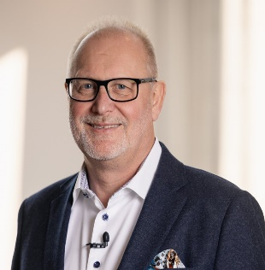
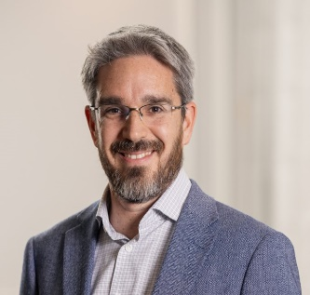
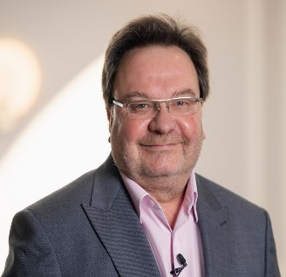
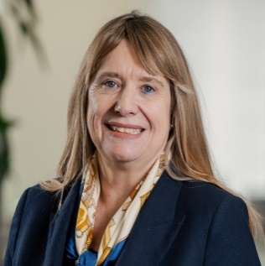
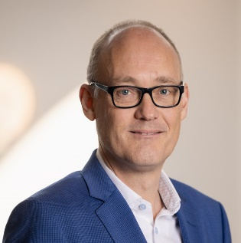
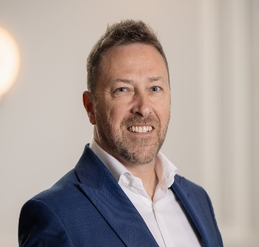
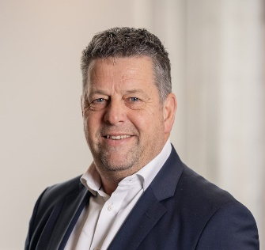
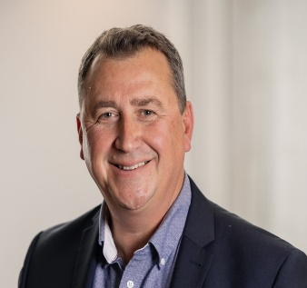
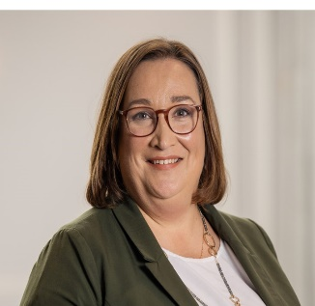
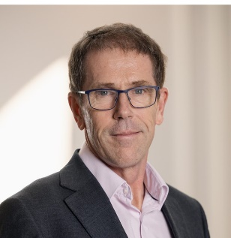
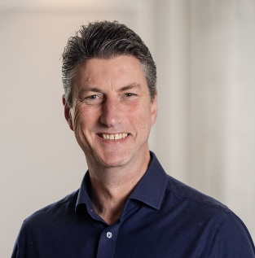

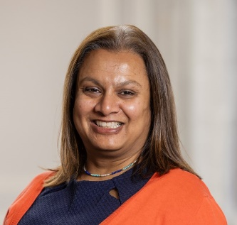
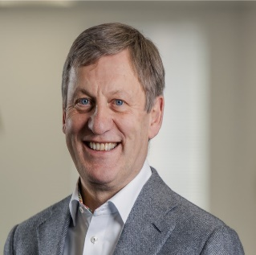
STARK UK EXECUTIVE TEAM
John Carter
CEO
STARK Building Materials UK
James Martin
Chief Financial Officer,
STARK Building Materials UK
Ian Goldsmith
Chief Strategy Officer
STARK Building Materials UK
Carol Kavanagh
HR Director, STARK Building Materials UK
Mark Esling
Chief Commercial Officer,
STARK Building Materials UK
Allan Davidson
Regional Managing Director, Jewson Scotland & North
Andy Jordan
Regional Managing Director,
Jewson South West
Neil Grindley
Regional Managing Director, Jewson West & Wales
Alex Davis
Managing Director Contracts Division (Minster & Jewson Civils Frazer)
Ranald Forbes
Chief Logistics Officer, STARK Building Materials UK
Patrick Knight
Chief Information Officer, STARK Building Materials UK
Helene Bradley
Communications Director,
STARK Building Materials UK
Nim Cassidy
General Counsel and Company Secretary, STARK Building Materials UK
Martin Meech
Strategic Property Officer, STARK Building Materials UK

Slide 41
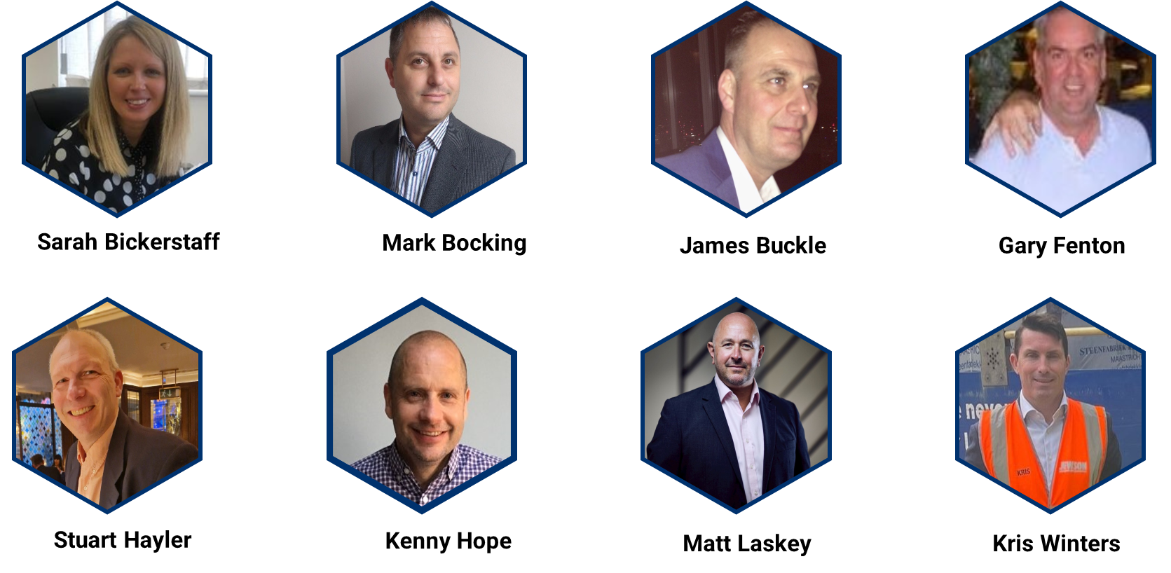
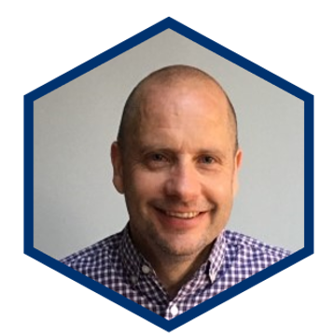
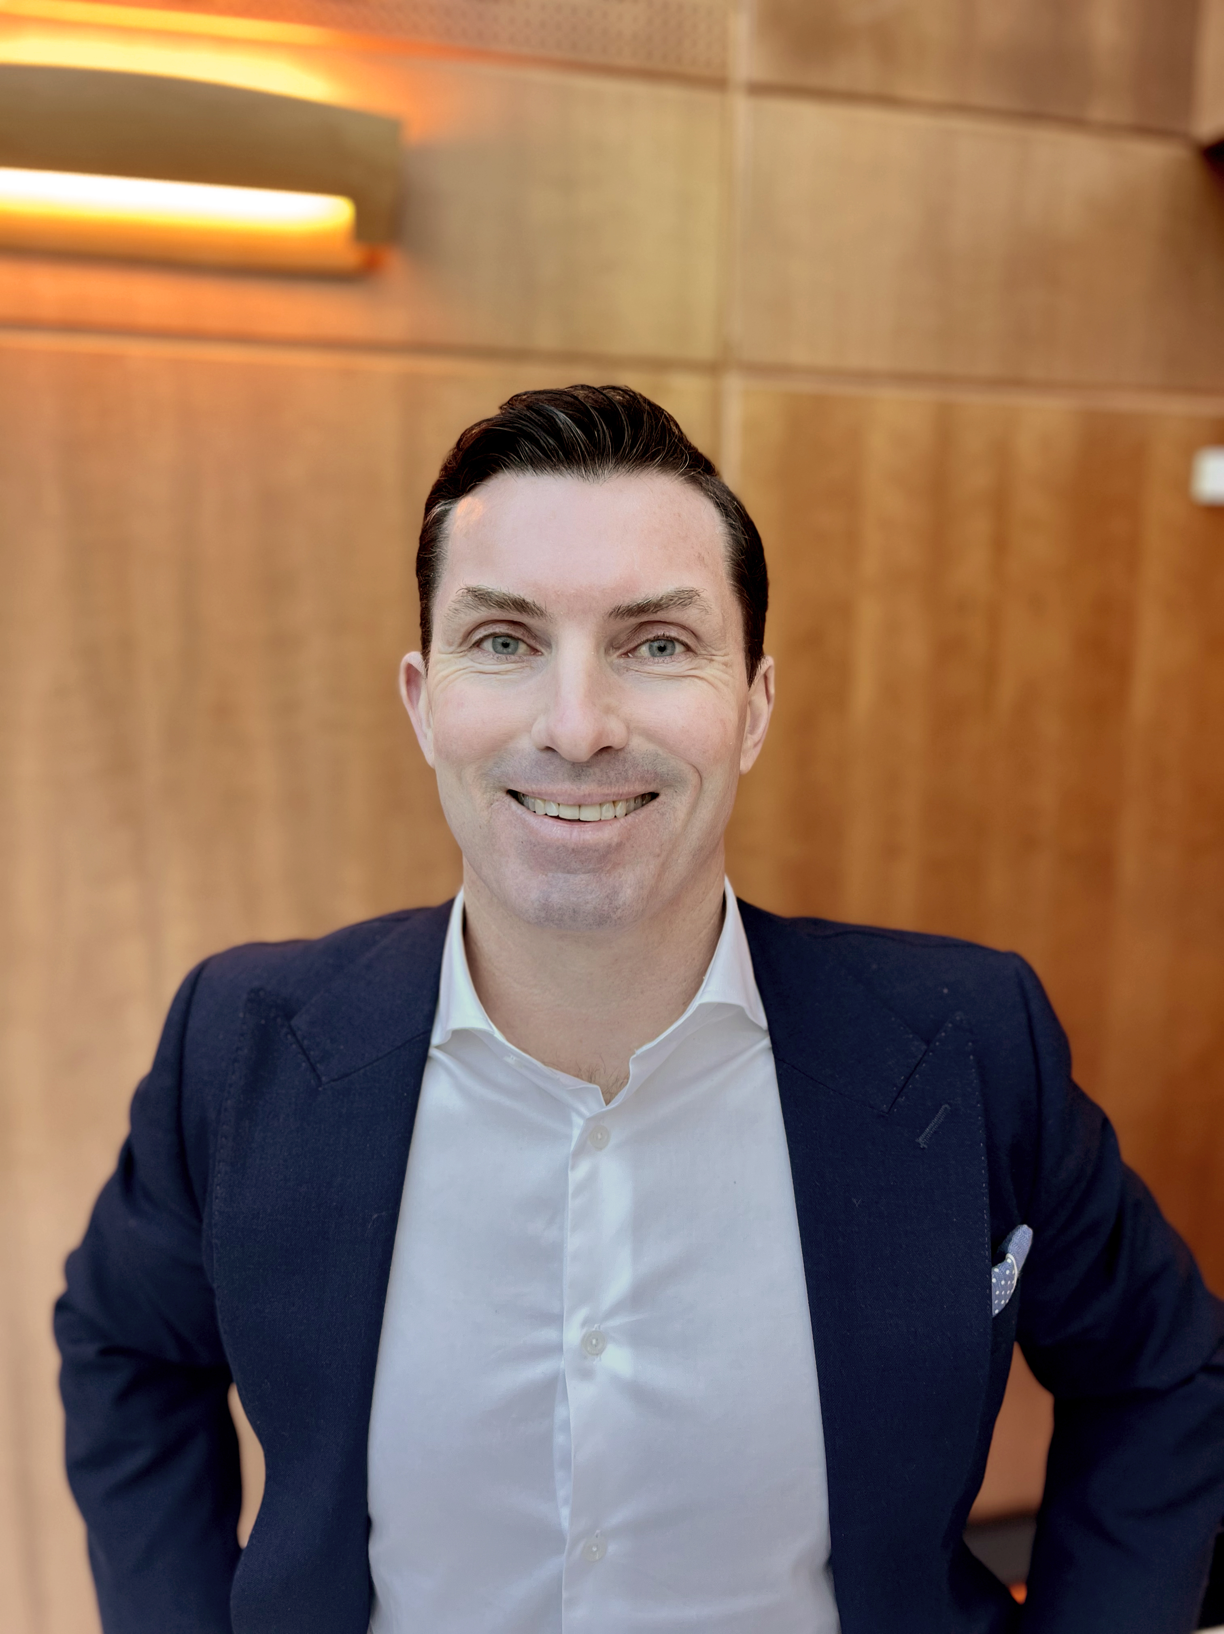
Jewson South East & London

Slide 42
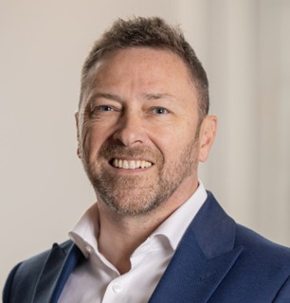
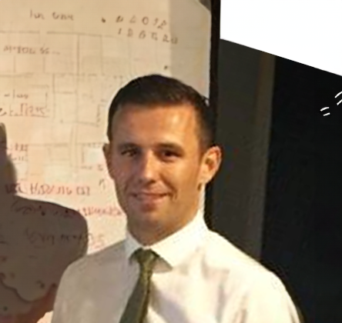
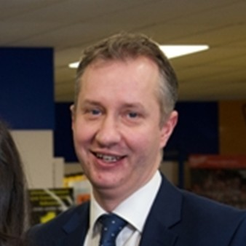
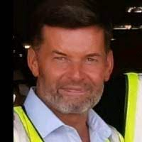
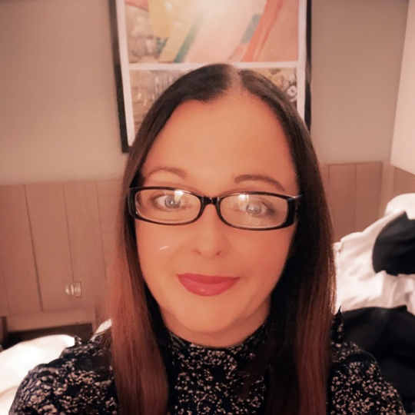
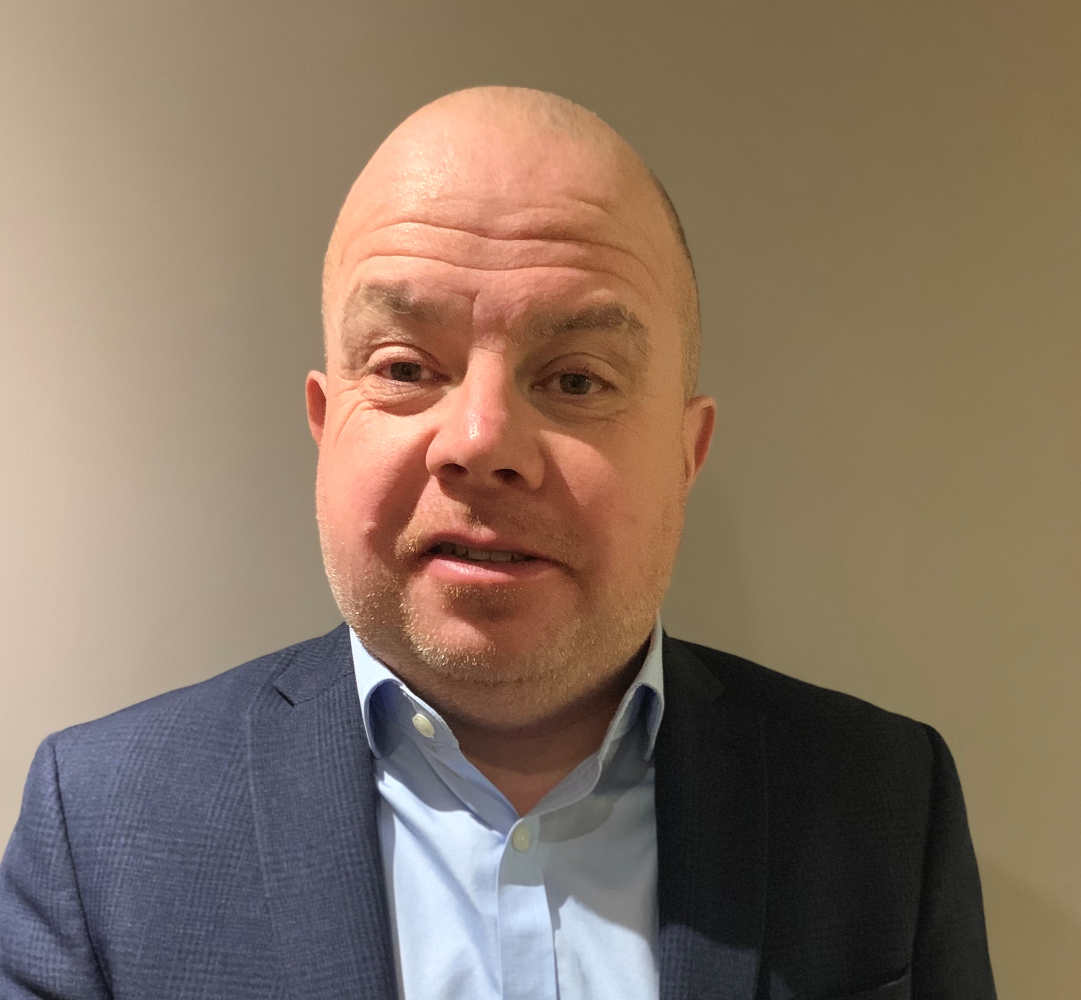
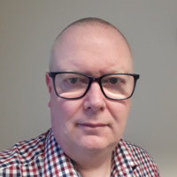
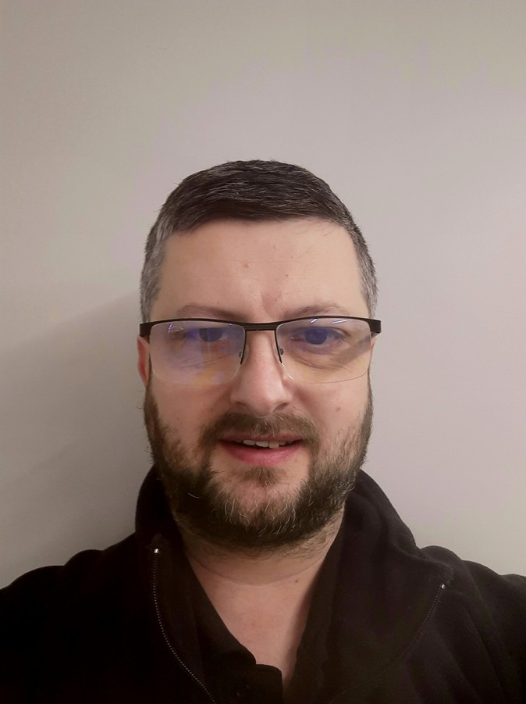
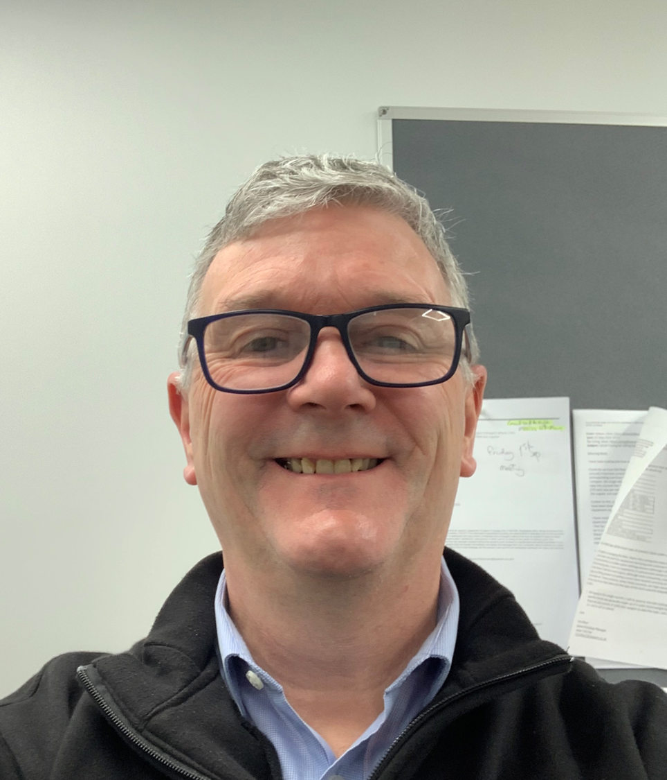
Jewson Scotland & North
TBC
Douglas Trainer
Regional Director West
Andy Kitching
Regional Director North
Regional Sales Director
Allan Davidson
Regional Managing Director
David McNamara
Regional Director East
Laura Lawler
HRBP
Tom Devlin
Regional Commercial Director
Colin Brown
RSOM
John Dunn
Regional Transport Mgr
Iain Alexander
Regional Tool Hire Director

Slide 43
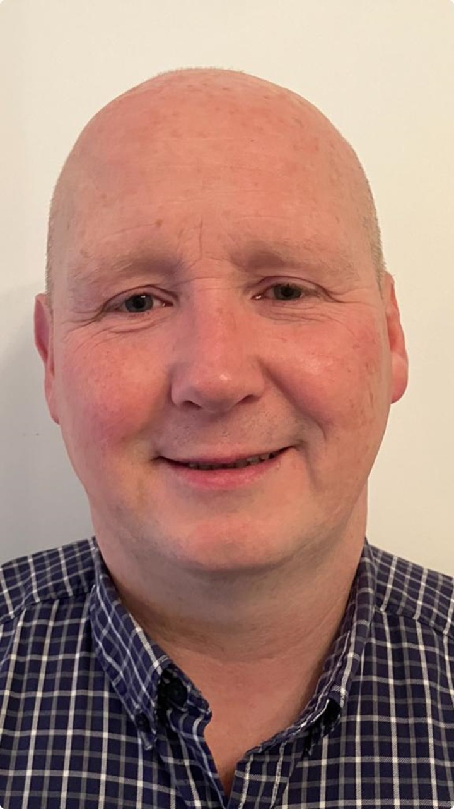
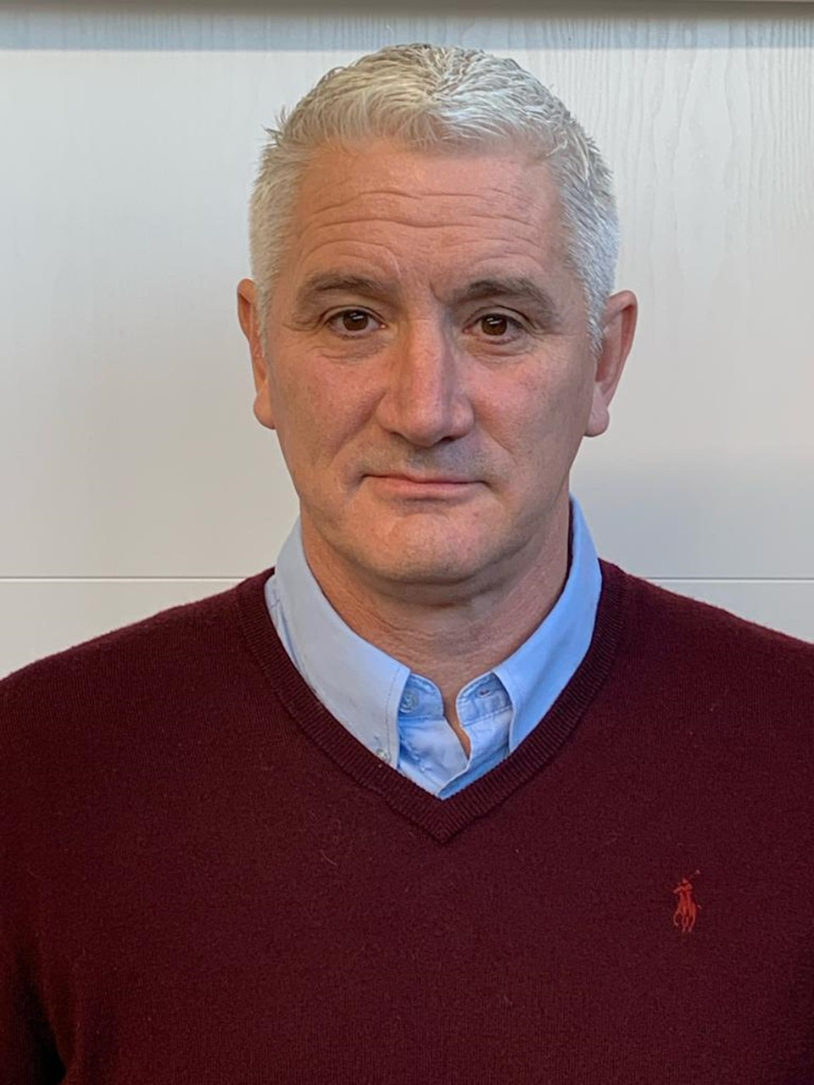



Jewson Wales & Central England
Sanj Kalsi
RD – Birmingham
& Welsh borders
Nathan Spurgeon
RD – Wales
Jason Pick
RD – Midlands
Craig Lewis
RD – Lincolnshire & South Yorkshire
TBC
RD - Manchester
TBC
RD – Northwest

Slide 44






Jewson South West
Gareth May
RD - Cornwall
& South Devon
Gary King
RD - Devon
& Somerset
James Smith
RD - Bristol,
Gloucester &
Wiltshire
Lee Thomas
RD - Hampshire,
IOW & Dorset
Darren Kirwan
Regional Sales Manager
Steve Moss
Regional Sales Manager

